Slide 1
The Closer Connection Rules – Tax Planning for In-Bound Taxpayers, Income Earned Abroad and Bona Fide Residents of Puerto Rico
Understanding When and Why the Closer Connection Test Matters
TUESDAY, JULY 8, 2025
1pm Eastern | 12pm Central | 11am Mountain | 10am Pacific
If you have any questions, please contact Customer Service at 1-800-926-7926 option 1.
Anthony Diosdi, Managing Shareholder, Diosdi & Liu, LLP, San Francisco
Mark H. Leeds, Partner, Pillsbury Winthrop Shaw Pittman, New York
NOTE: If you are seeking CPE credit, you must listen via your computer — phone listening is no longer permitted.

Slide 2
Continuing Education Credits
For live event only
In order for us to process your continuing education credit, you must confirm your participation in this webinar by responding to the attendance verification prompts and clicking the link to complete the Certification Process following the webinar.
If you don’t click the link following the webinar, you will receive an email including a link to complete the Certification Process within 24 hours.
For any assistance completing the Certification Process, call 1-877-297-2901 or email helpdesk@beaconlive.com. For additional information about continuing education, call us at 1-800-926-7926 option 2.
For CPE credits, attendees must participate until the end of the Q&A session and respond to six prompts during the program.

Slide 3
For live event only
Recording our programs is not permitted. However, today's participants can order a recorded version of this event at a special attendee price. Please call Customer Service at 800-926-7926 option 1 or visit Strafford’s website at www.straffordpub.com.

Slide 4
The Closer Connection Rules – Tax Planning for In-Bound Taxpayers, Income Earned Abroad and Bona Fide Residents of Puerto Rico
Understanding When and Why the Closer Connection Test Matters
July 8, 2025
 | Mark Leeds | Anthony Diosdi
 | Partner mark.leeds@pillsburylaw.com 212.858.1080 | Managing Shareholder adiosdi@sftaxcounsel.com 415.318.3990

Slide 5
Speakers
Mark Leeds, Partner - 212.858.1080 – mark.leeds@pillsburylaw.com
Mr. Leeds focuses his practice on the tax consequences of a variety of cross-border and domestic capital markets products and strategies, including migrating individuals and businesses to Puerto Rico in a manner that ensures compliance with both of the US tax rules for bona fide residents of Puerto Rico and the Puerto Rico Act 60 rules. Mark also has experience in responding to Internal Revenue Service examinations of US individuals and businesses who have become bona fide residents of Puerto Rico. In addition to cross-border Puerto Rico work, Mark advises on the tax aspects of capital markets, structured finance, derivatives, financial products and insurance transactions and has extensive experience working with both buyers and sellers to develop and structure complex derivatives.
Bio to come.

Slide 6
Rules for the US Taxation of Foreign Individuals

Slide 7
U.S. taxation of foreign nationals
Nonresident aliens (NRA)
Only subject to tax on income from sources within the United States (“U.S.-source” income)
U.S.-source income taxed under two different regimes:
U.S.-source income not connected with a U.S. business taxed at flat 30% rate (unless reduced rate in Code or a treaty)
U.S.-source income connected with a U.S. business taxed a normal graduated rates
Generally allowed fewer deductions
Generally cannot file as “married filing jointly” (MFJ) (absent making an election under section 6013(g) or (h))
Resident aliens
Subject to tax in the same manner as a U.S. citizen
Taxed on all income from all sources
Eligible for more deductions/credits than NRA
May file as married filing jointly

Slide 8
Part-Year Residents
In year of transition (arrival/departure) from United States, foreign national may be a resident alien for part of the year and NRA for part of the year
Taxed as an NRA for the part of the year the individual is an NRA
Taxed as a resident alien for the part of the year the individual is a resident alien

Slide 9
Determining residency
Foreign national is considered NRA unless individual meets any of the following residency tests:
Substantial presence test (SPT);
Lawful permanent resident test (“the green card test”)
First-year residency election under section 7701(b)(4)
A married foreign national may be able to elect to be treated as a full-year U.S. resident under section 6013(g) or (h) if specified requirements are satisfied.

Slide 10
Substantial presence test (SPT)
A foreign national is a U.S. resident under SPT in a calendar year if 2 requirements are met in that year:
Present in the United States on at least 31 days during the current year (CY); and
The sum of:
All days of U.S. presence during CY; plus
1/3 of the days of U.S. presence during the first preceding year; plus
1/6 of the days of U.S. presence during the second preceding year
equals or exceeds 183
Example:
Ben, a U.K. national, regularly travels to the United States for work. Present in the U.S. for 130 days in 2025 (CY) and was present in the U.S. for 120 days in both 2024 and 2023.
Ben is present for at least 31 days in 2025.
Applying the SPT formula to Ben’s presence results in 190 SPT days:
Ben is a resident (unless Closer Connection Exception applies)
Year | Actual Days | Ratio | SPT Days
2025 | 130 | 1 | 130
2024 | 120 | 1/3 | 40
2023 | 120 | 1/6 | 20
Total |  |  | 190

Slide 11
Defining U.S. Presence
“[A]n individual shall be treated as present in the United States on any day that he or she is physically present in the United States at any time during the day.”
Not counted for SPT, any day an individual is:
present as an exempt individual:
Student - Status can be extended beyond 5th year if substantial compliance with visa, no intent to reside in U.S. permanently
Professional athlete
Temporarily present in the U.S. to compete in charitable sports event
Exemption only applies to days competing in charitable sports event
present as an exempt individual:
Foreign government-related individual
full-time employee of an international organization; or
has diplomatic status
Teacher or trainee
J or Q visa holder in “substantial compliance” with visa
Not treated as exempt individual in CY if exempt teacher, trainee or student for any part of 2 of the last 6 calendar years
Period may be extended to four out of last six if compensation paid by foreign employer

Slide 12
Exceptions to Physical Presence Test Day Count
Not counted for SPT, any day an individual is:
prevented from leaving the U.S. because of a medical condition that arose while the individual was present in the U.S.;
A day is not excluded if:
subsequently able to leave the U.S. and then remains beyond a reasonable period for making arrangements to leave, or
Medical condition arose during a prior stay in the U.S. and the individual returns to the U.S. for medical treatment
Pre-existing medical condition not covered by exception
in transit between two points outside the United States;
Physically present in the U.S. for fewer than 24 hours
Pursue activities substantially related to completing travel to foreign destination
No business meetings in the airport! Business calls?

Slide 13
Passing Through Exceptions
Not counted for SPT, any day an individual is:
a regular commuter residing in Canada or Mexico commuting to and from employment/self-employment in the United States
Considered to commute regularly if commute to a place of employment in the U.S. from residence in Canada or Mexico on more than 75% of workdays during the working period.
Commute:
Travel to place of employment (or self-employment) and to return to a place of residence within 24-hr period
Exception only applies to daily commuters
Certain crew members of foreign vessels
Temporarily present in the U.S. as a regular member of the crew of a foreign vessel engaged in transportation between the U.S. and a foreign country or U.S. possession
Does not apply if individual engages in any U.S. trade or business on the day

Slide 14
What Constitutes the “United States” for SPT
For SPT purposes, United States includes:
The 50 states and the District of Columbia
Territorial waters of the United States
The seabed and subsoil of those submarine areas which are adjacent to the territorial waters of the United States and over which the United States has exclusive rights with respect to exploration and exploitation of natural resources.
It does NOT include:
Possessions and territories of the United States:
Territories:
American Samoa, Guam, The Commonwealth of Puerto Rico, The Commonwealth of the Northern Mariana Islands and the U.S. Virgin Islands
Possessions:
Baker Island, Howland Island, Jarvis Island, Johnston Island, Kingman Reef, Midway Islands, Palmyra Atoll, Wake Island, and other U.S. islands, cays, and reefs that are not part of any of the fifty states
Air space over the United States
Treas. Reg. § 301.7701(b)-1(c)(2)(ii)

Slide 15
Rules for Income Earned Abroad by US Persons

Slide 16
Qualified Residents
A US person who earns income abroad may exclude up to $130,000 (2025 limit) of that income from US tax if (s)he is a qualified resident.
A qualified resident must have a tax home in a foreign country.
Presence test – one of two tests must be met:
Must be a bona fide resident of the foreign country or
During 12 consecutive months, must spend at least 330 days in such country
While the US person need not establish that (s)he has a closer connection to the foreign country than the US, courts have employed similar tests. See Morgan, TC Mem. 2022-20.

Slide 17
Tax Home Alone Insufficient for Exclusion
Even if a US person has a tax home in a foreign country, the earned income exclusion is unavailable if the individual has an “abode” within the US.
Abode is looser than closer connection because an abode can be the primary residence of the earner without causing a loss of the exclusion.
Courts compare familial, economic & personal ties to the US to those ties abroad in determining if an individual has an abode in the US. This is similar to the closer connection test.

Slide 18
Determining When an Individual Is a Bona Fide Resident of Puerto Rico

Slide 19
Bona Fide Residency Tests
Section 937 of the US Tax Code provides that an individual qualifies as a Bona Fide Resident of Puerto Rico only if the person meets ALL of the following three tests:
Presence Test
Tax Home Test
Closer Connection Test

Slide 20
Bona Fide Residency Tests: Presence Test
Presence Test: The Presence Test can be met in any of five ways:
The individual is present in Puerto Rico (“PR”) at least 183 days during the taxable year;
The individual is present in PR a minimum of 549 days during the 3-year period that includes the current taxable year and the two preceding taxable years, as long as the individual is also present in PR for a minimum of 60 day during each year of the 3-year period;
The individual’s presence in the United States (“US”) does not exceed of 90 days during the taxable year;
The individual generates no “earned income” from sources within the US (i.e., compensation for labor or personal services rendered by the individual in the US in excess of $3,000), and is present in Puerto Rico for more days than in the US; or
The individual has “no significant connection” to the US.

Slide 21
Presence Test: Counting Puerto Rico Days
Physical presence in Puerto Rico for any length of time during a given day counts as a “day” in PR
Physical presence in the US for any length of time during a given day counts as a “day” in the US, except that if on the same day the individual is also present in PR, the presence in the US does not count as a day of presence in the US
Any day that an individual is outside PR to receive or to accompany a parent, spouse or child who is receiving “qualified medical treatment” (in-patient care in a hospital or hospice) will be considered as a “day of presence” in PR
Any day during a 14-day period within which an individual is outside PR because he/she has left or is unable to return due to a major disaster (i.e. FEMA/Presidential declaration State of Disaster) will be considered as a “day of presence” in PR
Days spent in transit between two points outside of the US do not count as a day in the US, so long as the presence in the US is less than 24 hours
Days in the US as a student (as defined in US-IRC §152(f)(2)) do not count as “days of presence” in the US
Days in the US serving as an elective representative of PR, or as a full time elected or appointed official or employee of the PR Government, do not count as “days of presence” in the US
Physical presence in PR and in another US possession (i.e., US Virgin Islands) on the same day, count as a “day of presence” in PR if the tax home of the individual is in PR

Slide 22
Bona Fide Residency Tests: Tax Home Test
Tax Home Test: This test is met if the individual does not have a tax home outside Puerto Rico for any part of the taxable year.
A person’s “tax home” is that individual’s regular or principal place of business that is claimed by the taxpayer for purposes of determining income tax deductions for traveling expenses while away from home in the pursuit of a trade or business.
If the individual does not have a regular or principal place of business—because the individual is not engaged in a trade or business or does not conduct it at any principal place—then the tax home is the individual’s regular place of abode in a real and substantial sense.

Slide 23
The Tax Home & Closer Connection Exception for Foreign Persons

Slide 24
Closer connection exception (CCE) for Foreign Persons
An individual is not treated as meeting SPT with respect to any current year if 3 requirements are met:
The individual is present in the United States on fewer than 183 days during the current year, and
It is established that for the current year such individual:
has a tax home in a foreign country, and
has a closer connection to such foreign country than to the United States

Slide 25
Tax “Home” Is a Misnomer
“The term “tax home” means, with respect to any individual, such individual's home for purposes of section 162(a)(2) (relating to traveling expenses while away from home).”
“[A]n individual's tax home is considered to be located at the individual's regular or principal (if more than one regular) place of business.”
Generally, the city/metropolitan area of an individual’s regular work or post of duty
Not necessarily the location of one’s personal principal residence
Facts and circumstances analysis:
Total time spent at each location
Level of business activity at each location with consideration for:
Financial return, and
Performance of administrative and managerial tasks
Whether the location is temporary or permanent
Reasonably expected to be for one year or less, and lasts for one year or less
“If the individual has no regular or principal place of business because of the nature of the business, or because the individual is not engaged in carrying on any trade or business within the meaning of section 162(a), then the individual's tax home is the individual's regular place of abode in a real and substantial sense”

Slide 26
Tax Home Factors
Regular place of abode in a real and substantial sense
Facts and circumstances determination, IRS considers 3 objective factors:
Whether the taxpayer performs a portion of his business in the vicinity of his claimed abode and uses such abode (for purposes of his lodging) while performing such business there;
Whether the taxpayers living expenses incurred at his claimed abode are duplicated because his business requires him to be away therefrom; and
Whether the taxpayer:
has not abandoned the vicinity in which his historical place of lodging and his claimed abode are both located,
has a member or members of his family (marital or lineal only) currently residing at his claimed abode, or
uses his claimed abode frequently for purposes of his lodging.

Slide 27
Other Tax Home Requirements
Tax home maintained by individual must be in existence for entire current year
CCE not available in year tax home shifts to United States
Example: Individual comes to U.S. to begin a work assignment expected to exceed 12-months, tax home shifts to U.S. in arrival year, so CCE not available
Must be located in the same country for which the individual is claiming to have the closer connection

Slide 28
When Is There a Closer Connection?
Must establish that the individual has maintained more significant contacts with a foreign country than with the United States
Facts and circumstances determination, regulations provide a non-exhaustive list of considerations:
The location of:
the individual's permanent home;
house, an apartment, or a furnished room
owned or rented by the alien individual
dwelling must be available at all times, continuously, and not solely for stays of short duration
the individual's family;
regulations do not define whether “family” is limited to immediate family, but more weight likely granted to location of immediate versus extended

Slide 29
More Closer Connection Factors
The location of:
personal belongings
automobiles, furniture, clothing and jewelry owned by the individual and his or her family
Presumably, location of taxpayer’s personal belongings granted more weight than family members’ belongings
Not limited to the above – art, photo albums, sentimental keepsakes
social, political, cultural or religious organizations with which the individual has a current relationship;
Registered parishioner? Gym membership? Belong to a country club? Member of a social club?
where the individual conducts his or her routine personal banking activities;
where the individual conducts business activities (other than those that constitute the individual's tax home);
the jurisdiction in which the individual holds a driver's license;
the jurisdiction in which the individual votes;
Generally, a foreign national will not be able to vote in a U.S. election (although may be able to vote in certain state or local elections)

Slide 30
More Closer Connection Factors
Must establish that the individual has maintained more significant contacts with a foreign country than with the United States
Contacts not listed in the regulations, but potentially relevant:
Location of real property owned by the individual?
Location of family pet?
Location of friend group?
Location of personal, financial, and legal documents?
Derive most income?
Location of doctors, financial advisors, business advisors, legal counsel?
Qualify for any foreign country’s national health plan?
The country of residence designated by the individual on forms and documents;
Bad facts: if the individual files forms to be treated a nonresident in the foreign country, or deregisters from the social security system
The types of official forms and documents filed by the individual.
Form W-8 (Certificate of Foreign Status) or Form W-9 (Payer's Request for Taxpayer Identification Number).
Consider any foreign country equivalents

Slide 31
Morgan Facts (Earned Income Exclusion)
Taxpayer spent most of his time in Saudi Arabia
Free time was spent as president of a Saudi social club organizing local charitable events for local charities
Frequented Saudi grocery stores and restaurants
Vacationed with other US persons in Saudi Arabia to surrounding countries
Obtained an Iqama (Saudi resident alien card)
Saudi medical insurance and drivers license
Did not seek work outside of Saudi Arabia

Slide 32
Adapting New York Case Law on Snowbirds
Does the individual maintain significant ties to the US after the move?
Has the home in the US been sold or rented or listed for sale in a manner that it is reasonable to expect that it will be sold?
If business is continued in the US, does the individual attempt to manage the business from Puerto Rico?
Where is correspondence sent?
Safe deposit boxes location?
Boat & airplane registration location?

Slide 33
Closer Connection Filing Requirements
Must file a fully completed Form 8840, Closer Connection Exception Statement for Aliens (or successor form) with the IRS to be eligible to claim CCE
Attach to Form 1040-NR, U.S. Nonresident Alien Income Tax Return and file by due date (including extensions) of tax return to address shown in tax return instructions
If not tax return required, Form 8840 mailed to IRS by due date for filing Form 1040NR:
Department of the Treasury, Internal Revenue Service Center, Austin, TX 73301-0215
Penalty for not filing
If Form 8840 is not timely filed, not eligible to claim CCE
Required to include all days of presence in the United States
Exceptions:
Not penalized if individual can show by “clear and convincing evidence” that individual “took reasonable actions to become aware of the filing requirements and significant affirmative steps to comply with those requirements”
Secretary has discretion to disregard failure to file timely when in best interest of government

Slide 34
Internal Revenue Service Puerto Rico Residency Audits

Slide 35
IRS Campaigns: Background
Congressional Letter. In December 2019, certain members of Congress sent a letter to the Treasury secretary expressing concerns about benefits of US tax laws for taxpayers that become residents of Puerto Rico
IRS Report. At the same time, Congress directed the IRS to determine the number of individuals that had relocated to Puerto Rico since 2012 and been granted tax exemptions under Act 22
IRS identified 2,331 individuals who had obtained Act 22 benefits from 2012-2019
Criminal Indictment. In October 2020, a CPA with a large accounting firm was indicted on charges related to assisting clients fraudulently obtain benefits associated with Act 22
IRS Activity. In a May 2024 interview with The New York Times, then-IRS Commissioner Danny Werfel said the IRS has audited “dozens” of taxpayers and assessed “millions of dollars” related to Puerto Rico tax incentives, with the IRS enforcement campaign in Puerto Rico only in its “early chapters”

Slide 36
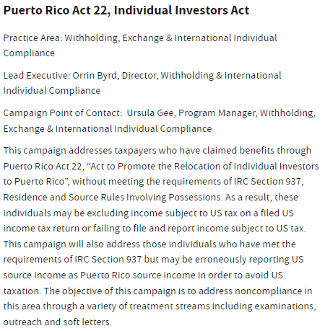
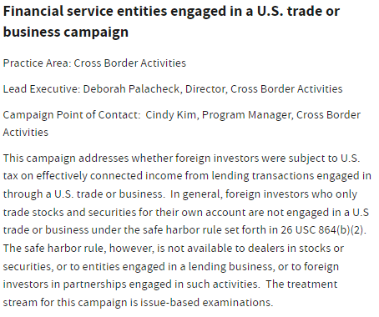
Relevant IRS Audit Campaigns

Slide 37
IRS Campaigns: Pattern IDR – Residency Questions

Slide 38
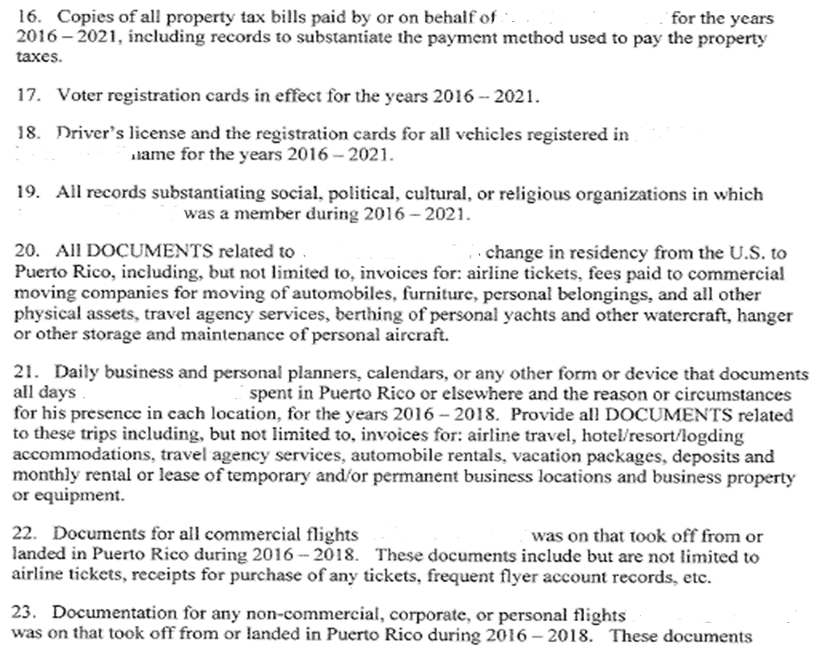
IRS Campaigns: Pattern IDR – Residency Questions

Slide 39
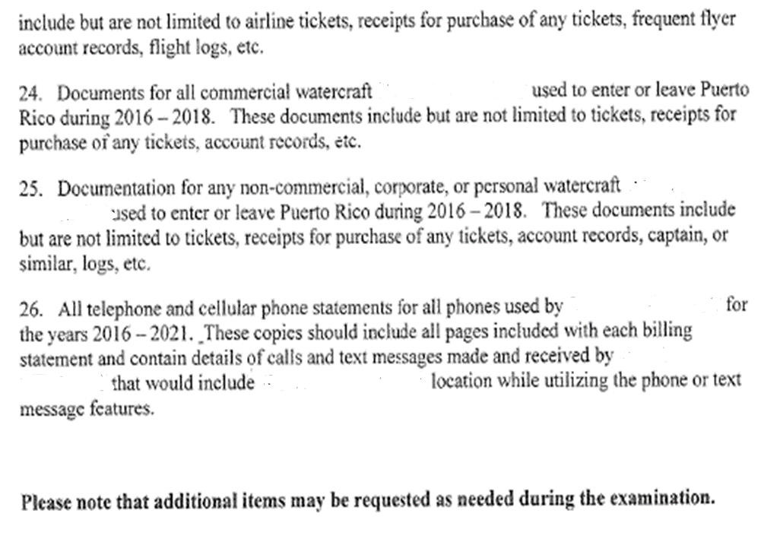
IRS Campaigns: Pattern IDR – Residency Questions

